Slide 1
The Project Management Processes

Slide 2
Project Management Processes
Project Processes
Process Groups
Knowledge Areas

Slide 3
Project Management Processes
Project Management Process
  It is a set of interrelated actions and activities to achieve a product, service or result
  Each process has inputs, the tools and techniques that can be applied, and the outputs
  It ensures the effective flow of the project through out its existence

Slide 4
Process Groups
The Project management processes are grouped in to five categories known as Project Management Process Groups or Process Groups
  Initiating Process Group
  Planning Process Group
  Executing Process Group
  Monitoring and Controlling Process Group
  Closing Process Group

Slide 5
Process Groups
Initiating Process Group
  The Initiating Process Group consists of those processes which are performed to define a new project or a new phase of an existing or on-going project
  It requires authorization to start the project or phase
  Stakeholders are identified
  Development of the project charter and the stakeholder register

Slide 6
Process Groups
Planning Process Group
  It consists of those processes which are carried out to establish the scope , define and refine the objectives, and develop a suitable course of action to attain those objectives
  The main outcomes of the project planning processes are the project management plan and the project documents

Slide 7
Process Groups
Executing Process Group
  The executing process group consist of those processes carried out to complete the work defined in the project management plan (an outcome of the planning process)
  A large amount of work is involved as well as project budget expenditure

Slide 8
Process Groups
  Project execution may require planning updates as well as re-base lining which may include changes to activity durations, unanticipated risks etc.
  These changes may affect the project management plan or documents and result in change requests which require modification of the project management plan as well as project documents and ultimately require establishing new baselines

Slide 9
Process Groups
Monitoring and Controlling Process Group
  It consists of those processes which are required to track, review, and regulate the progress as well as the performance of the project
  Project performance is observed and measured on a regular basis to identify and rectify any variances from the project management plan

Slide 10
Process Groups
Closing Process Group
  It consists of all those processes which are carried out to finalize activities across all project management process groups to formally complete the project, phase, or contractual obligations

Slide 11
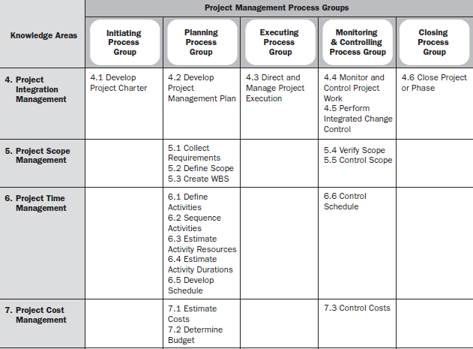


Slide 12
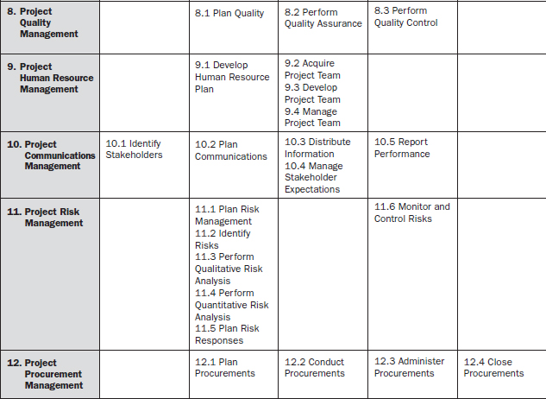

Slide 13
Knowledge Areas
Project Integration Management includes the processes and activities needed to identify, define, combine, unify, and coordinate the various processes and project management activities within the Project Management Process Groups. In the project management context, integration includes characteristics of unification, consolidation, articulation, and integrative actions that are crucial to project completion, successfully managing stakeholder expectations, and meeting requirements. The Project Integration Management processes include:
  Develop Project Charter—The process of developing a document that formally authorizes a project or a phase and documenting initial requirements that satisfy the stakeholder’s needs and expectations.
  Develop Project Management Plan—The process of documenting the actions necessary to define, prepare, integrate, and coordinate all subsidiary plans.

Slide 14
Knowledge Areas
  Direct and Manage Project Execution—The process of performing the work defined in the project management plan to achieve the project’s objectives.
  Monitor and Control Project Work—The process of tracking, reviewing, and regulating the progress to meet the performance objectives defined in the project management plan.
  Perform Integrated Change Control—The process of reviewing all change requests, approving changes, and managing changes to the deliverables, project documents, and project management plan.
  Close Project or Phase—The process of finalizing all activities across all of the Project Management Process Groups to formally complete the project or phase.

Slide 15
Knowledge Areas
Project Scope Management includes the processes required to ensure that the project includes all the work required, and only the work required, to complete the project successfully. Managing the project scope is primarily concerned with defining and controlling what is and is not included in the project. Project Scope Management processes include:
  Collect Requirements—The process of defining and documenting stakeholders’ needs to meet the project objectives.
  Define Scope—The process of developing a detailed description of the project and product.
  Create WBS—The process of subdividing project deliverables and project work into smaller, more manageable components.
  Verify Scope—The process of formalizing acceptance of the completed project deliverables.
  Control Scope—The process of monitoring the status of the project and product scope and managing changes to the scope baseline.

Slide 16
Knowledge Areas
Project Time Management includes the processes required to accomplish timely completion of the project. Project Time Management processes include:
  Define Activities—The process of identifying the specific actions to be performed to produce the project deliverables.
  Sequence Activities—The process of identifying and documenting relationships among the project activities.
  Estimate Activity Resources—The process of estimating the type and quantities of material, people, equipment, or supplies required to perform each activity.
  Estimate Activity Durations—The process of approximating the number of work periods needed to complete individual activities with estimated resources.
  Develop Schedule—The process of analyzing activity sequences, durations, resource requirements, and schedule constraints to create the project schedule.
  Control Schedule—The process of monitoring the status of the project to update project progress and managing changes to the schedule baseline.

Slide 17
Knowledge Areas
Project Cost Management includes the processes involved in estimating, budgeting, and controlling costs so that the project can be completed within the approved budget. Project Cost Management processes include the following:
  Estimate Costs—The process of developing an approximation of the monetary resources needed to complete project activities.
  Determine Budget—The process of aggregating the estimated costs of individual activities or work packages to establish an authorized cost baseline.
  Control Costs—The process of monitoring the status of the project to update the project budget and managing changes to the cost baseline.

Slide 18
Knowledge Areas
Project Quality Management includes the processes and activities of the performing organization that determine quality policies, objectives, and responsibilities so that the project will satisfy the needs for which it was undertaken. It implements the quality management system through policy and procedures with continuous process improvement activities conducted throughout, as appropriate. Project Quality Management processes include:
  Plan Quality—The process of identifying quality requirements and/or standards for the project and product, and documenting how the project will demonstrate compliance.
  Perform Quality Assurance—The process of auditing the quality requirements and the results from quality control measurements to ensure appropriate quality standards and operational definitions are used.
  Perform Quality Control—The process of monitoring and recording results of executing the quality activities to assess performance and recommend necessary changes.

Slide 19
Knowledge Areas
Project Human Resource Management includes the processes that organize, manage, and lead the project team. The project team is comprised of the people with assigned roles and responsibilities for completing the project. The Project Human Resource Management processes include:
  Develop Human Resource Plan—The process of identifying and documenting project roles, responsibilities, required skills, reporting relationships, and creating the staffing management plan.
  Acquire Project Team—The process of confirming human resource availability and obtaining the team necessary to complete project assignments.
  Develop Project Team—The process of improving the competencies, team interaction, and the overall team environment to enhance project performance.
  Manage Project Team—The process of tracking team member performance, providing feedback, resolving issues, and managing changes to optimize project performance.

Slide 20
Knowledge Areas
Project Communications Management includes the processes required to ensure timely and appropriate generation, collection, distribution, storage, retrieval, and ultimate disposition of project information. The Project Communications Management processes include:
  Identify Stakeholders—The process of identifying all people or organizations impacted by the project, and documenting relevant information regarding their interests, involvement and impact on project success.
  Plan Communications—The process of determining the project stakeholder information needs and defining a communication approach.
  Distribute Information—The process of making relevant information available to project stakeholders as planned.
  Manage Stakeholder Expectations—The process of communicating and working with stakeholders to meet their needs and addressing issues as they occur.
  Report Performance—The process of collecting and distributing performance information, including status reports, progress measurements, and forecasts.

Slide 21
Knowledge Areas
Project Procurement Management includes the processes necessary to purchase or acquire products, services, or results needed from outside the project team to perform the work. Project Procurement Management includes the contract management and change control processes required to develop and administer contracts or purchase orders issued by authorized project team members. The Project Procurement Management processes include:
  Plan Procurements—The process of documenting project purchasing decisions, specifying the approach, and identifying potential sellers.
  Conduct Procurements—The process of obtaining seller responses, selecting a seller, and awarding a contract.
  Administer Procurements—The process of managing procurement relationships, monitoring contract performance, and making changes and corrections as needed.
  Close Procurements—The process of completing each project procurement.

